Slide 1
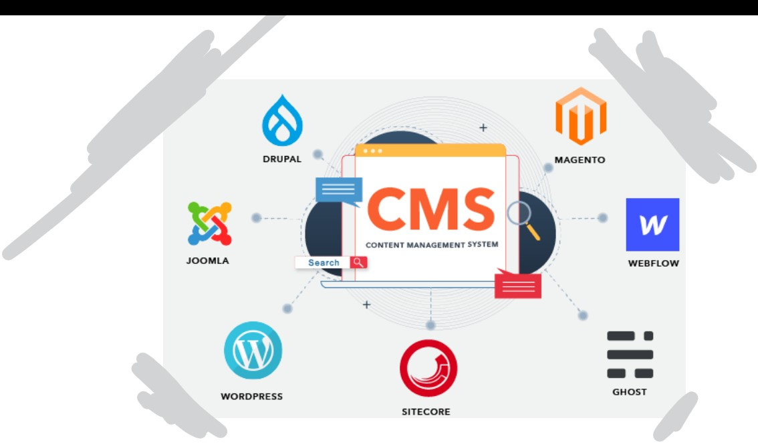
Content Management System (03)
INSTRUCTOR: Sir Farooq Iqbal
Team members:
1- SYEDA ANSHRAH GILLANI
2-Umema Mujeeb
3-Maheen ALI
4-AREEJ ASIF

Slide 2
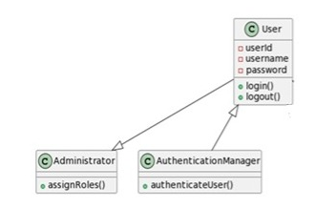
1- User Management Subsystem

Slide 3
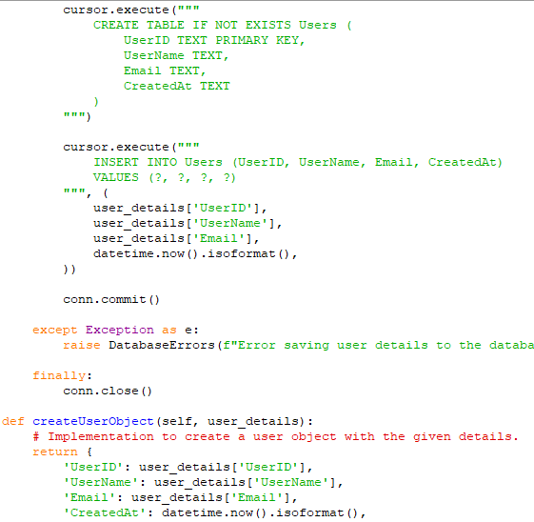
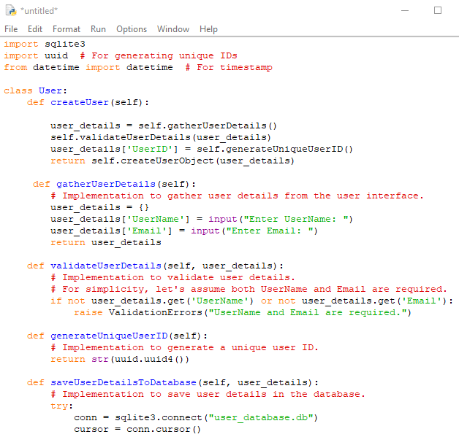
User Class – Implementation

Slide 4
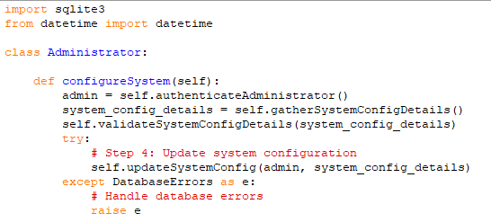
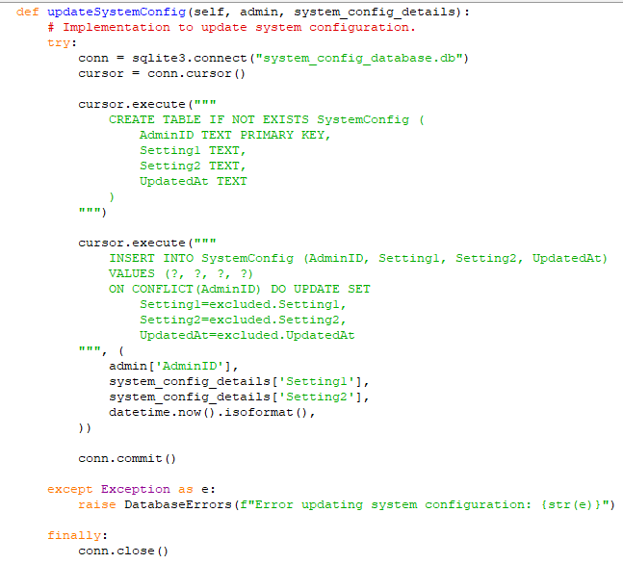
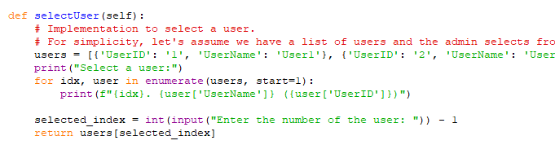
Administrator Class – Implementation

Slide 5
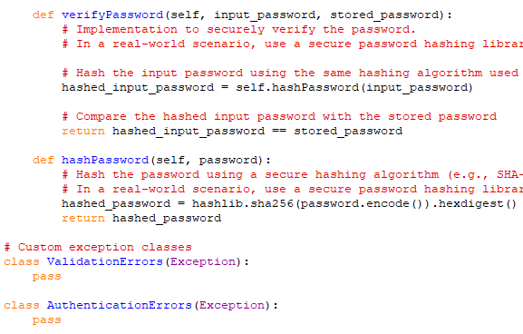
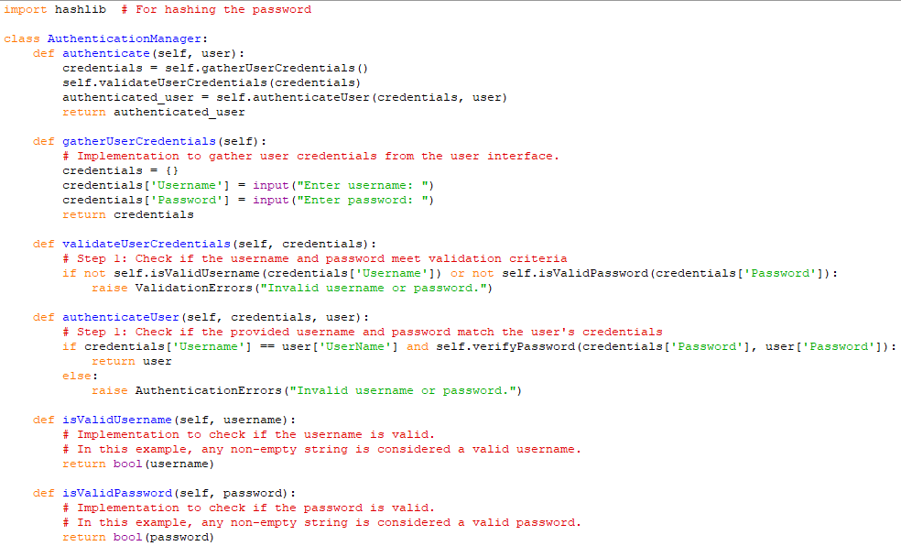
AuthenticationManager Class – Implementation

Slide 6
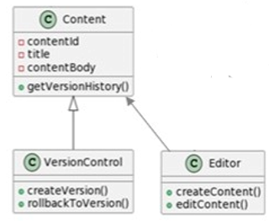
2- Content Creation & Editing Subsystem

Slide 7
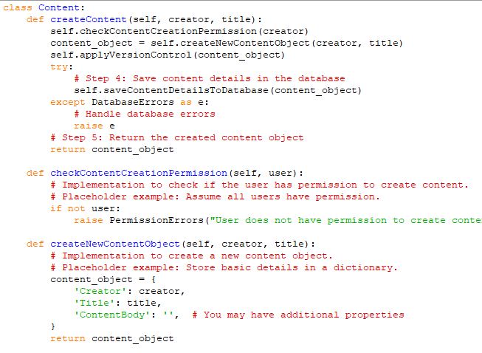
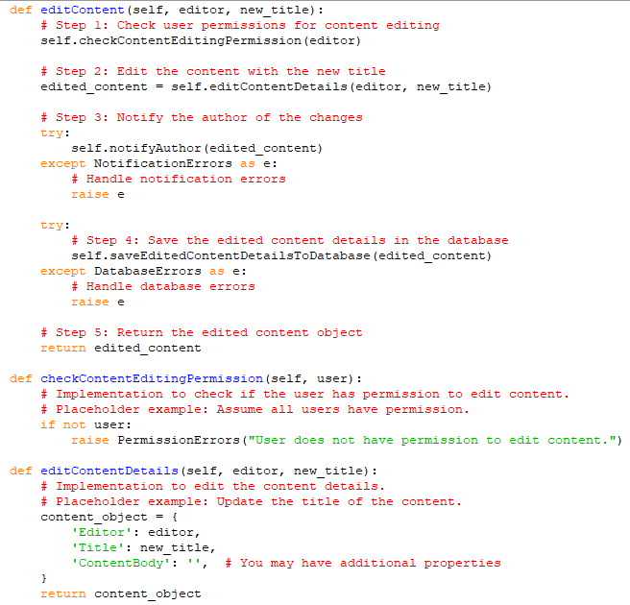

Content Class – Implemention

Slide 8
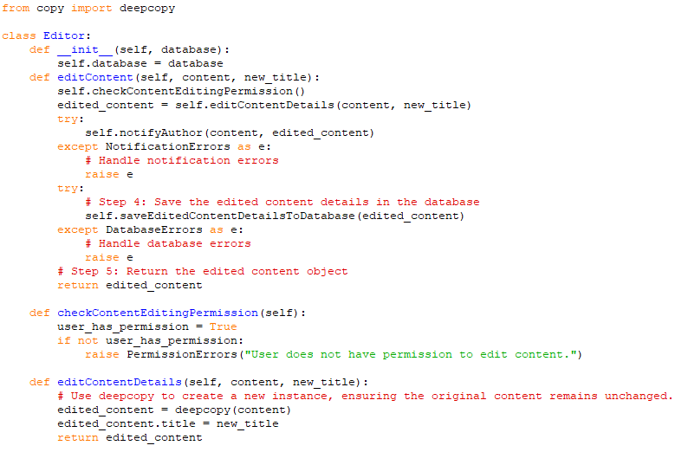
Editor Class –Implementation

Slide 9
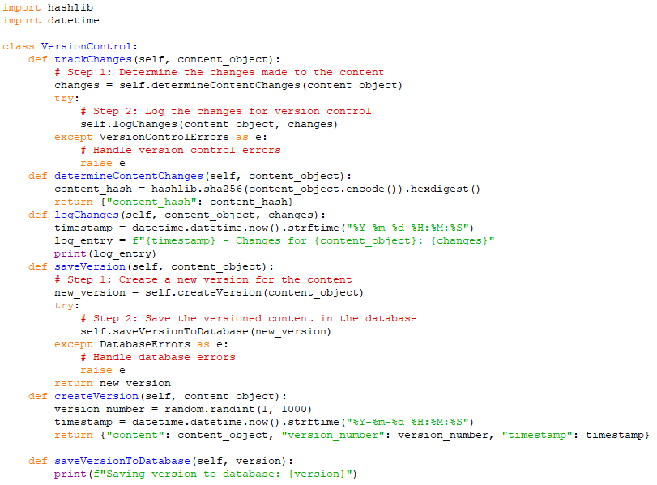
VersionControl Class – Implementation

Slide 10
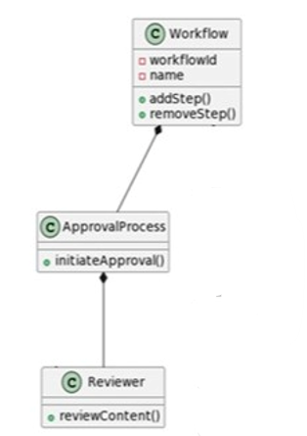
3- Workflow & Approval Subsystem

Slide 11
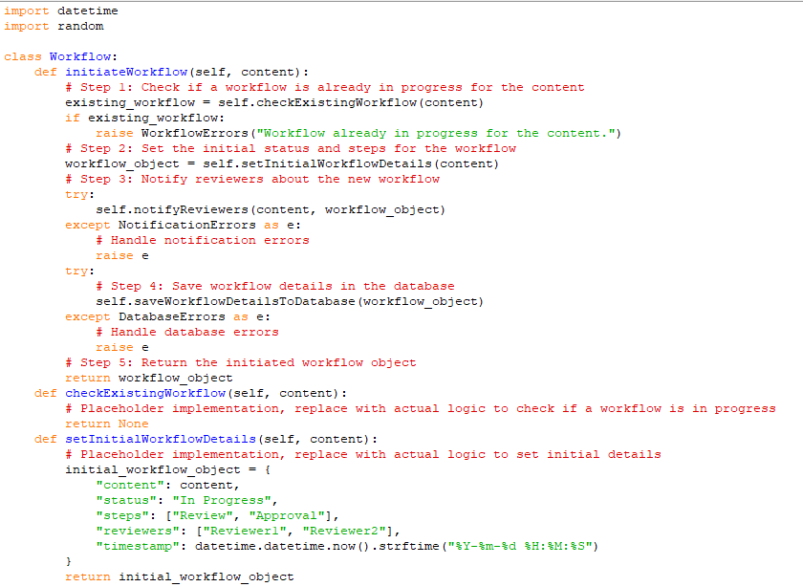
Workflow Class – Implementation

Slide 12
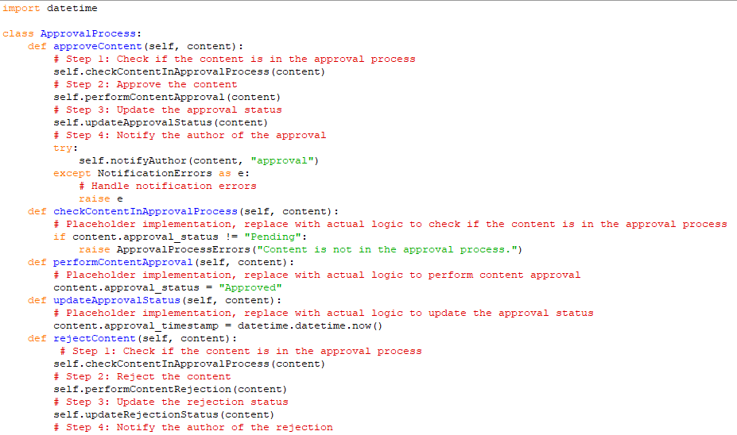
ApprovalProcess Class – Implementation

Slide 13
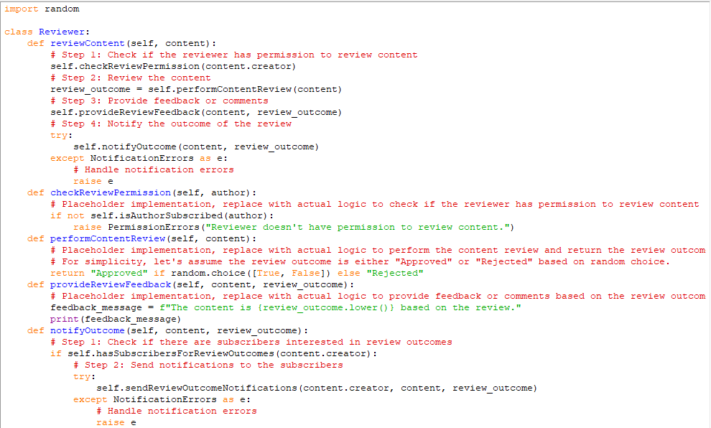
Reviewer Class – Implementation

Slide 14
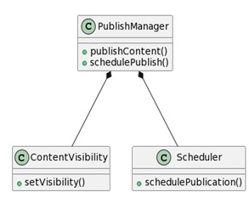
4- Publishing Subsystem

Slide 15
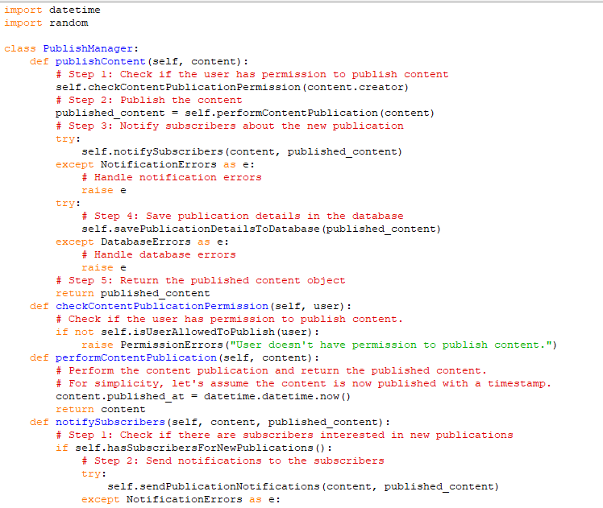
Publish Manager Class – Implementation

Slide 16
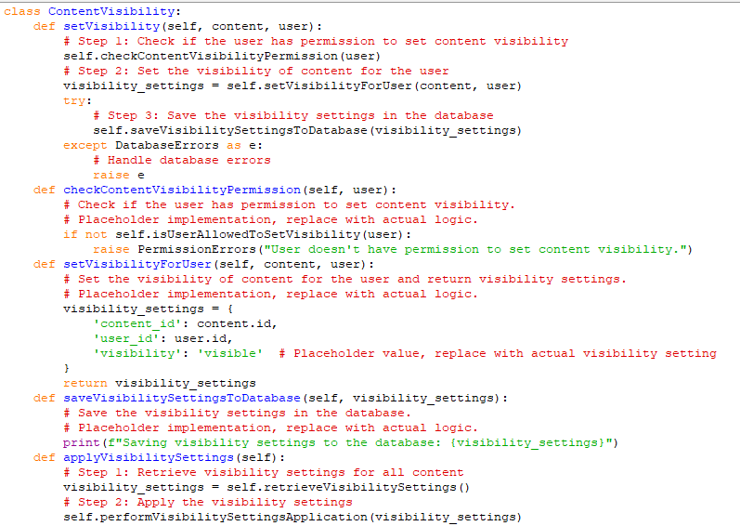
Content Visibility Class – Implementation

Slide 17
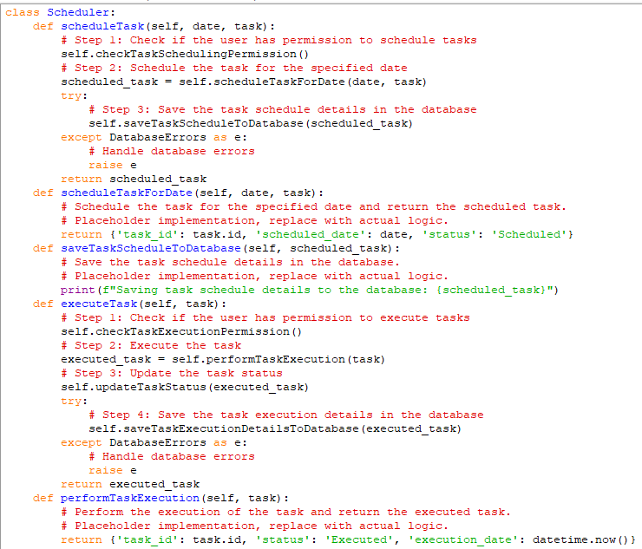
Scheduler Class – Implementation

Slide 18
THANK YOU

